Slide 1

Ionic Compounds

Slide 2
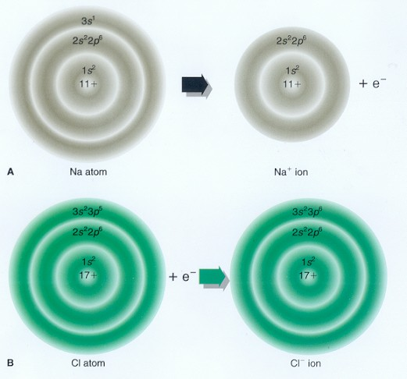

Slide 3
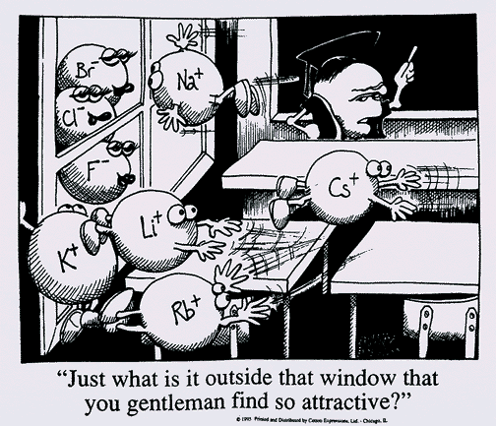
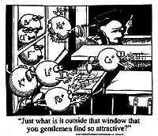

Slide 4
common examples
Fe₂O₃ iron III oxide
NaCl sodium chloride

Slide 5
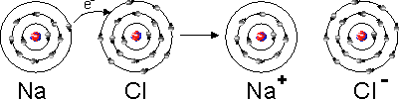


Slide 6
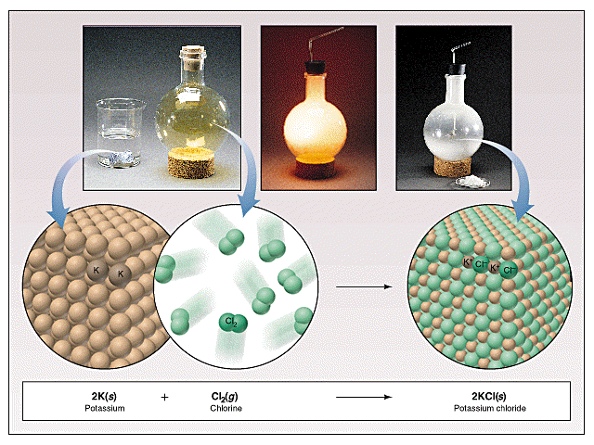

Slide 7
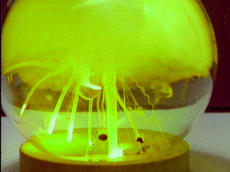

Sodium in chlorine gas

Slide 8
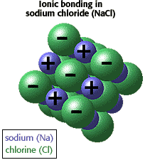
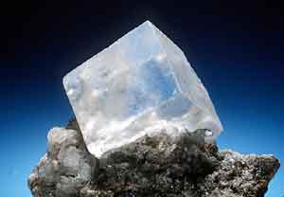

Slide 9
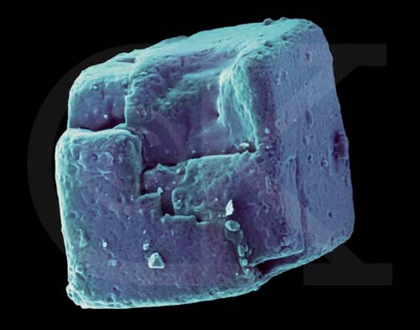

Slide 10
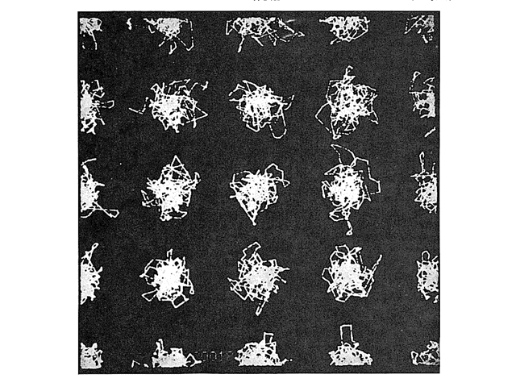
This shows a trace of the position of ions within an ionic crystal at room temperature over time.

Slide 11
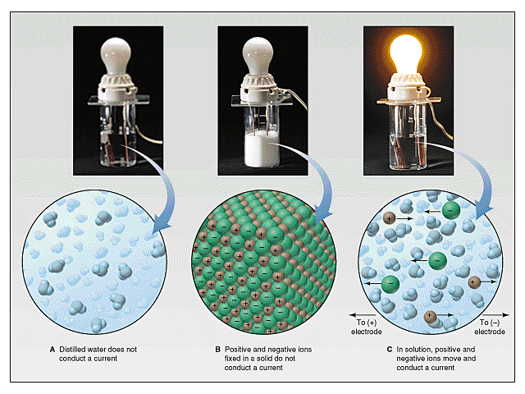

Slide 12
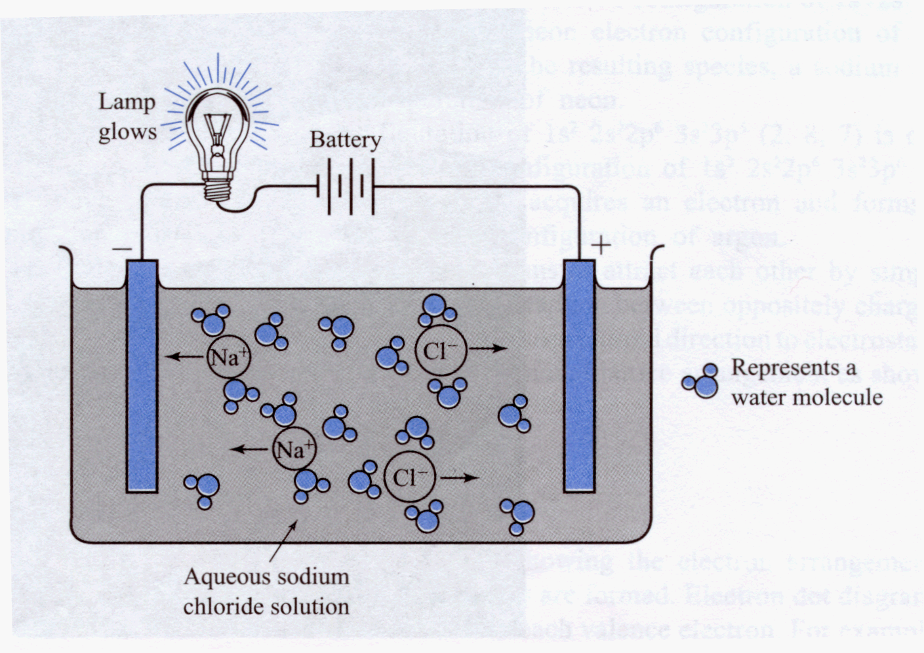
Conductivity of ionic solutions

Slide 13
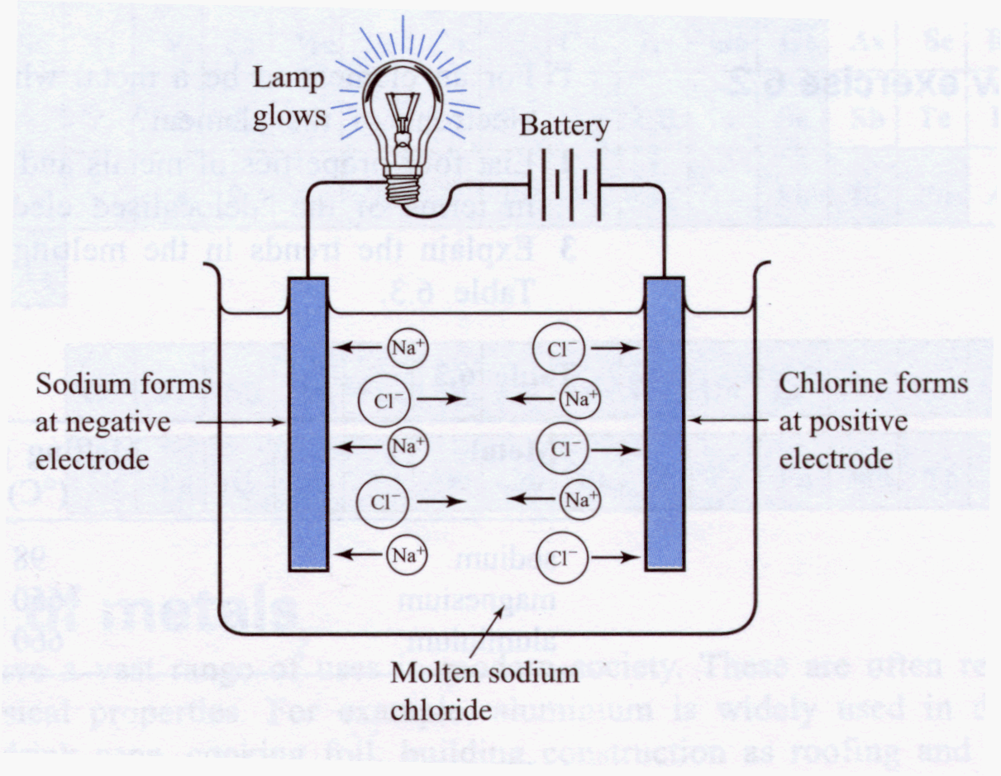
Conductivity of molten ionic salts

Slide 14
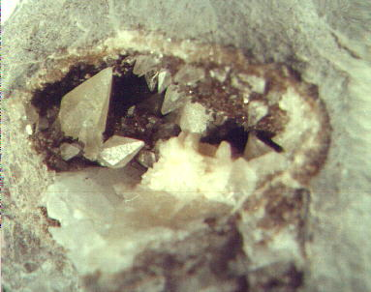
Calcite (Calcium carbonate) columbia

Slide 15
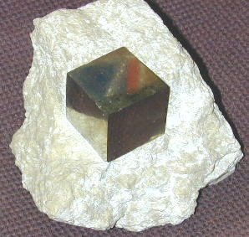
Pyrite (fool’s Gold) – FeS₂

Slide 16
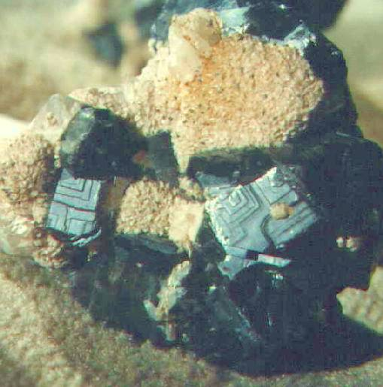
Galena - PbS
galena

Slide 17
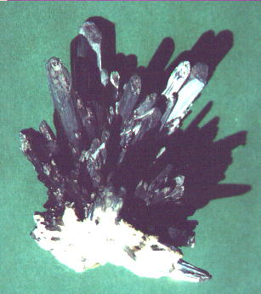
Stibnite – antimony sulfide

Slide 18
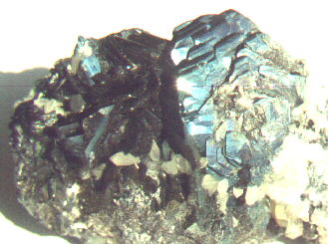
Hematite – Fe₂O₃

Slide 19
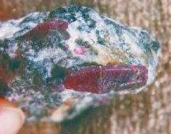
Ruby – Al₂O₃ india

Slide 20
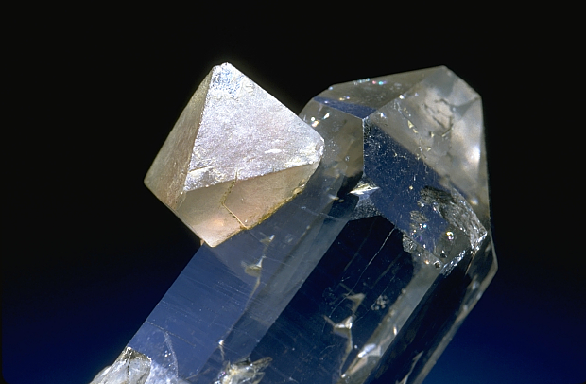
Fluorite CaF₂ (on quartz)

Slide 21
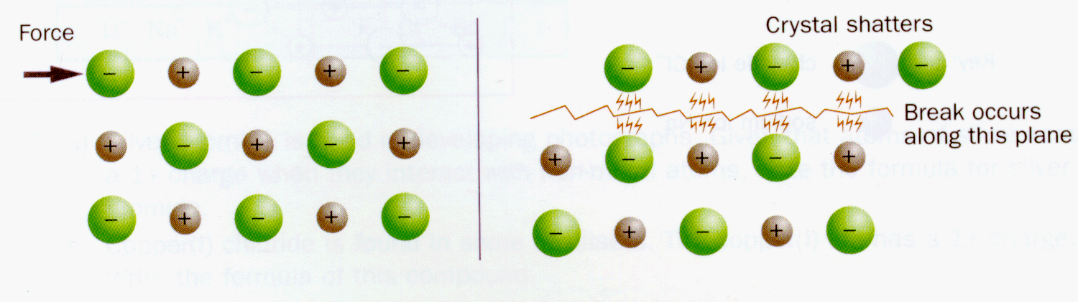
Why are ionic solids brittle?

